Slide 1
Introduction to Sonic pi
Presented by Mike tang

Slide 2
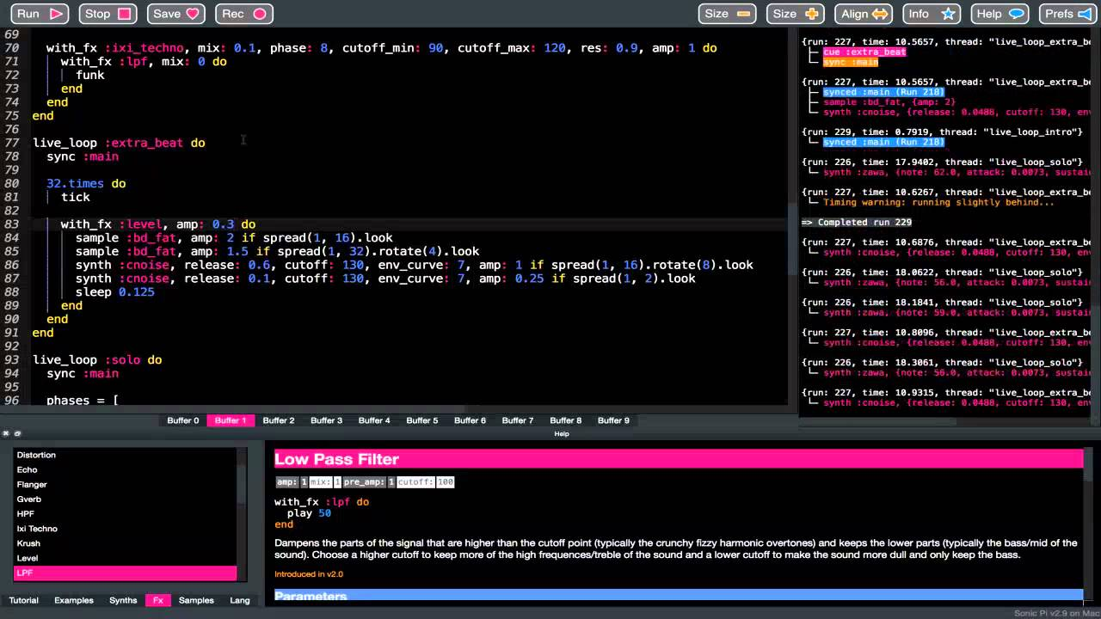
About Sonic Pi

Slide 3
What's Sonic Pi
Sonic Pi is a free, open-source live coding music environment designed to create music and sounds through code.
Developed by Dr. Sam Aaron.
It runs on Ruby (Front-end) and allows users to compose or perform music in real time by writing code in real-time. And its sound engine is built on SuperCollider (Back-end).

Slide 4
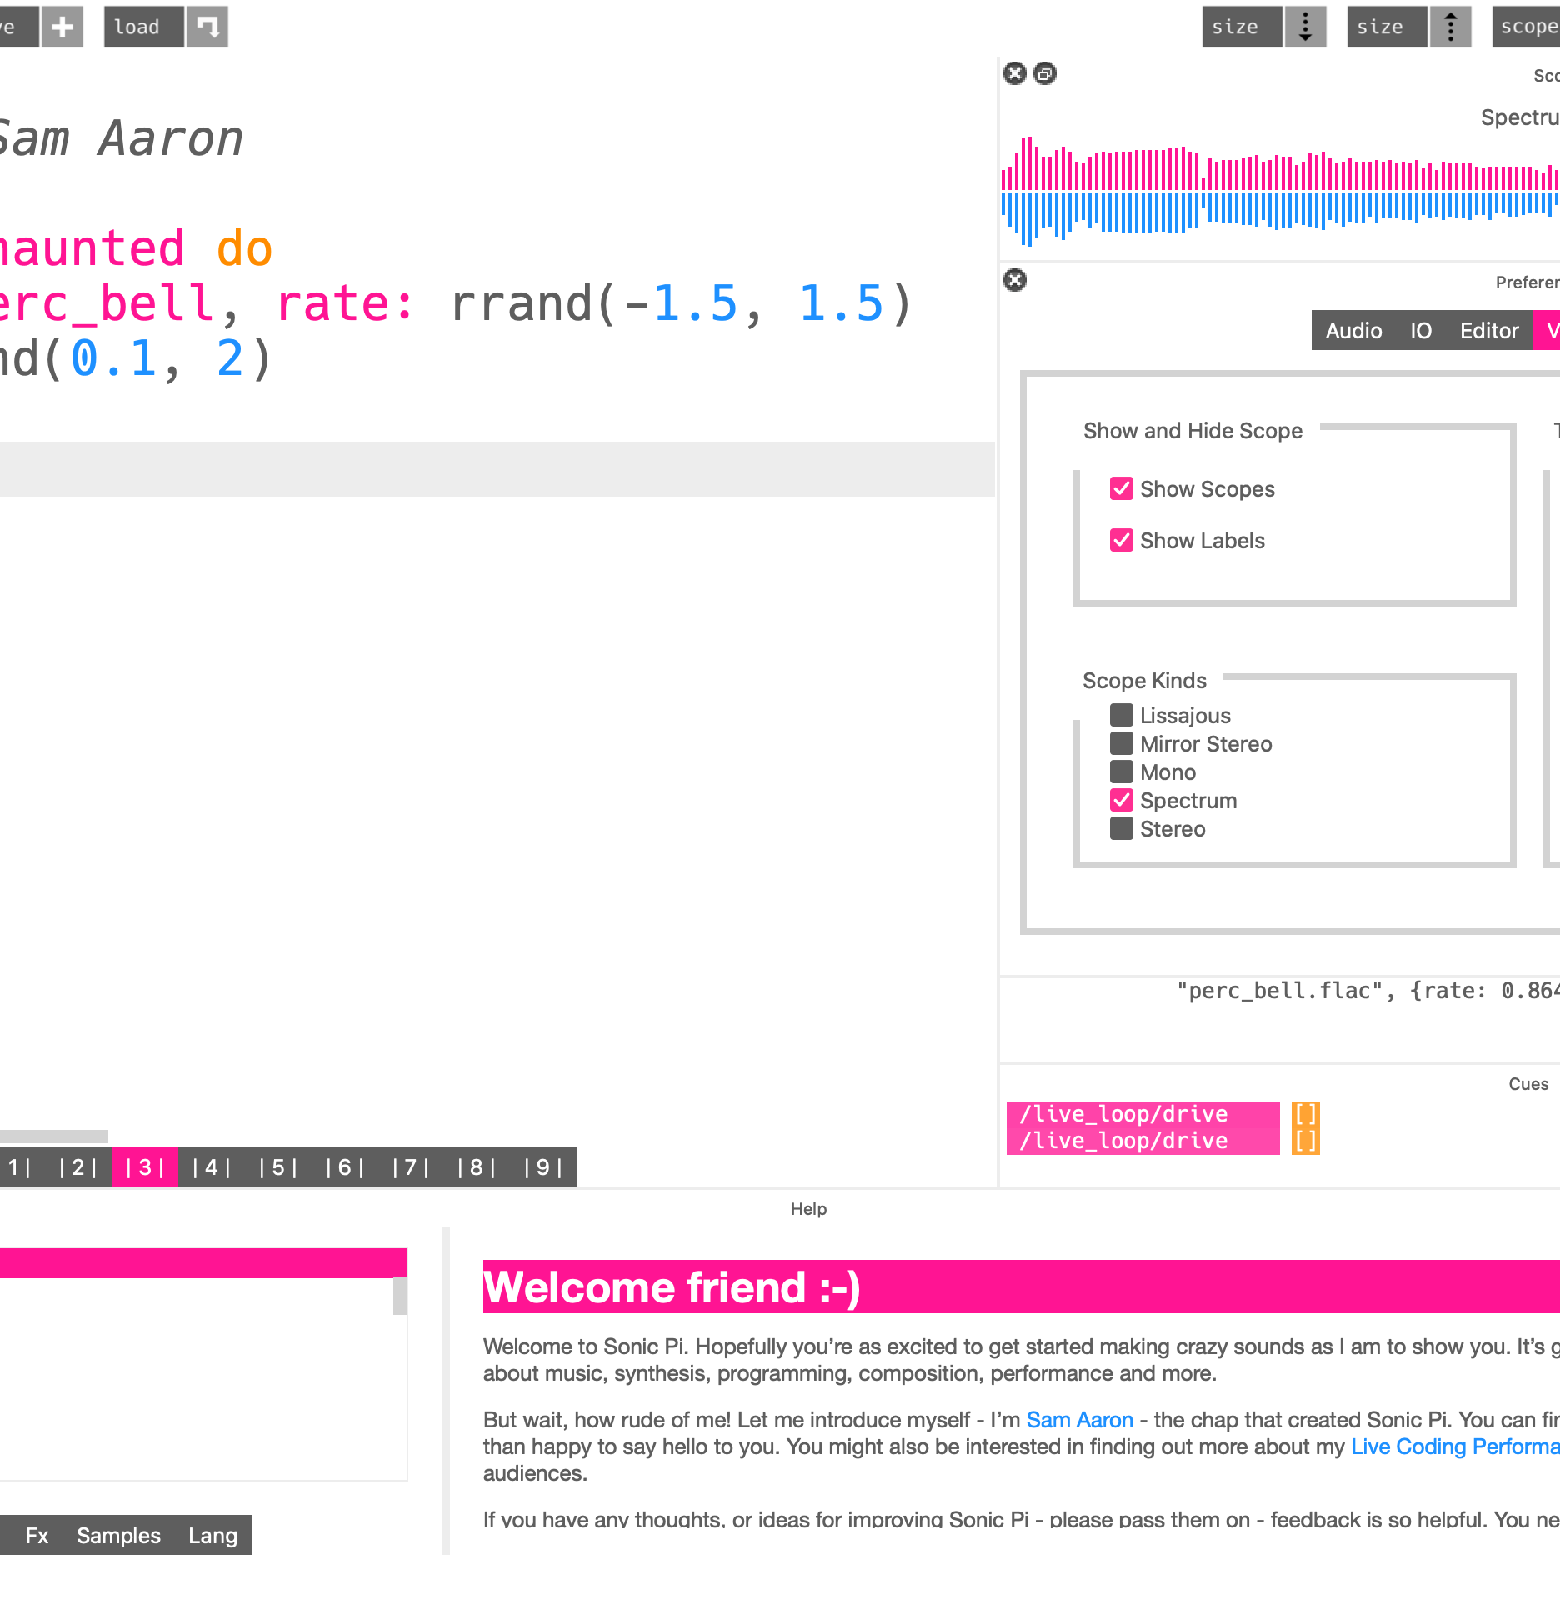
Why Sonic pi
Sonic Pi’s Key Advantage:
Immediate Feedback
Code produces sound instantly
Feedback is direct and sensory
Easier to understand cause and effect
Encourages experimentation

Slide 5
Simple Syntax (Beginner Friendly)
Simple Syntax for Beginners
Uses clear musical commands
Easy to read and understand
Examples:
play
sleep
Sample
Lower barrier to entry

Slide 6
Similar Programming Concepts in Sonic Pi
loops
Given a do/end block, repeats it forever. Plain loops like this are like black holes.
The loop must either sleep or sync each time round otherwise it will stop and throw an error. This is to stop the loop from spinning out of control and locking the system.
live_loop
A loop that runs continuously and con be modified in real time to create layers.
load_sample
rand
Sync
Used to synchronize different live loops in time
Live coding:
define :my_sound
Fx:
compressor
distortion
lpf
reverb
tremolo

Slide 7
Limitations
Not a general-purpose language
Limited for large-scale software development
Focused mainly on music creation and live coding
Less suitable for complex non-musical tasks

Slide 8
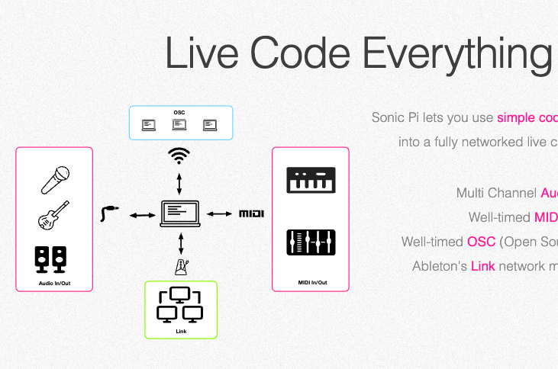
Example

Slide 9
Quote
Thank You ~

